Slide 1

Hidden Casualties:
The Opioid Crisis and Infectious Diseases
OFFICE OF THE ASSISTANT SECRETARY FOR HEALTH
Brett Giroir, MD
ADM, U.S. Public Health Service
Assistant Secretary for Health and
Senior Advisor for Mental Health and Opioid Policy
May 18, 2018

Slide 2
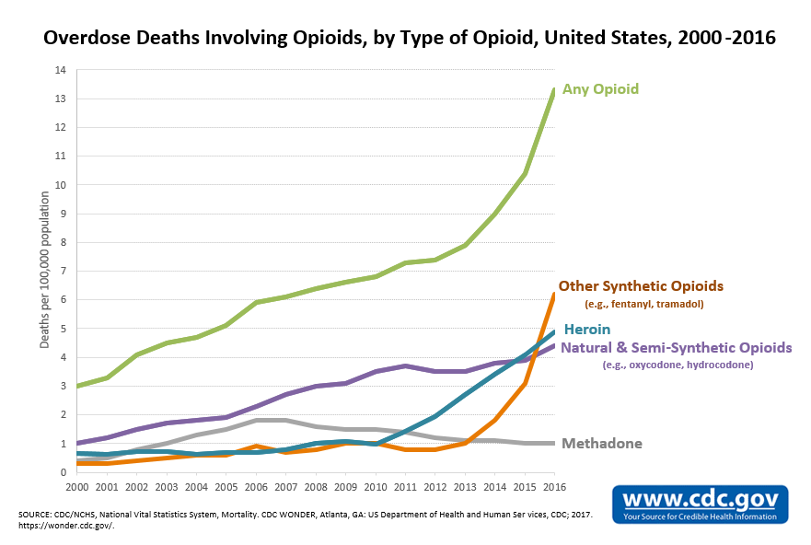
OPIOID DEATHS, US: 2000-2016
Latest Statistics
Sept 2016 – Sept 2017
Drug overdose deaths: 67,944
Opioid deaths: 45,657
Drug overdose deaths increased
13% from previous year
Opioid overdose deaths increased
16% from previous year
Overdose deaths accounted for
2.4% of overall US deaths
Injection drug use has increased
93% (2004-2014)

Slide 3
PERCENT CHANGE IN DRUG OVERDOSE DEATHS BY STATE
States with Notable Increases
Ohio 26%
Pennsylvania 33%
Indiana 28%
Illinois 18%
New Jersey 43%
Delaware 33%
Nebraska 33%
CDC Statistics, Published On Line, May 16, 2018

Slide 4
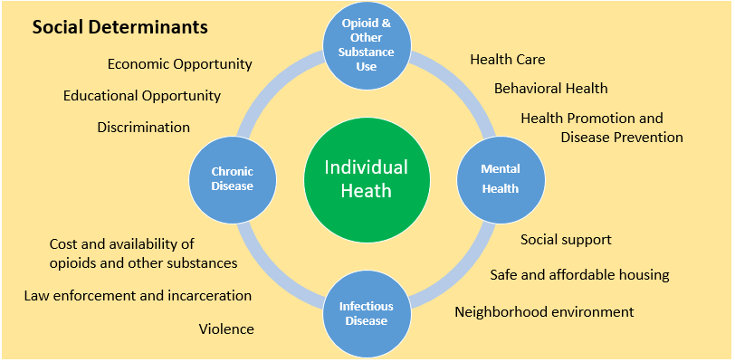
SYNDEMICS (Synergistic Epidemic)
A set of interconnected health problems that often have common root causes and interact synergistically with one problem making the other worse.

Slide 5

CONSEQUENCES OF THE OPIOID EPIDEMIC
HIV
Hepatitis B
Hepatitis C
Endocarditis
Skin, bone, and joint infections

Slide 6

EFFECTS OF OPIOID USE DURING PREGNANCY
Outcomes in the fetus
Growth restriction
Prematurity
Death
Outcomes in the Newborn
Low birthweight
Small head circumference
Neonatal abstinence syndrome
Outcomes in the Child
Developmental disorders
(Image from Neurology Advisor, June 2017)
(McQueen and Murphy-Oikonen, NEJM, 2016)

Slide 7
OASH AS A DRIVER OF SOLUTIONS
Senior advisor to the Secretary on matters of public health and science
Unequaled situational awareness of the nation’s health issues
  Position in the Immediate Office of the Secretary
  Diverse Offices (including Office of HIV/AIDS and Infectious Disease Policy)
  Presidential and Secretarial Advisory Committees
Catalyzes new partnerships, programs, health-promoting approaches
Provides evidence based guidelines and strategies:
Nutrition Guidelines, Fitness Guidelines; Healthy People 2020;
National HIV/AIDS Strategy; National Viral Hepatitis Action Plan
Current Mission:
Optimize the nation’s investment in health and science to advance health equity and improve the health of all people

Slide 8

DETERMINANTS OF LONGEVITY AND QUALITY OF LIFE

Slide 9
Office of the Assistant Secretary for Health PHILOSOPHY:
HEALTH
FOR ALL
Assure that everyone has a fair and realistic
opportunity to optimize their health
HEALTH
BY ALL
Distribute and democratize health care
knowledge, capabilities, and delivery
HEALTH
IN ALL
Prioritize health considerations in all sectors and
policy areas

Slide 10


NATIONAL ACADEMY OF MEDICINE / OASH WORKSHOP
Consequences of the Opioid Epidemic on the Spread of Infectious Disease: Incidence, Prevalence, and Mutually Beneficial Opportunities to Improve Prevention, Care, and Treatment in the United States
Will publish workshop summary report to inform future program and policy recommendations for OHAIDP and its partners (Summer 2018)
Nationwide dissemination plan for the workshop summary report, which will guide important future directions for an integrated national opioid response
A live and archived webcast of the workshop

Slide 11
SENIOR ADVISOR FOR MENTAL HEALTH AND OPIOID POLICY
Point person for the development and implementation of the response to the opioid epidemic throughout HHS
Working with every agency and office to prioritize actions, understand gaps, and develop new synergies
Engage partners throughout the federal government, at the state and local levels, as well as commercial, non-profit, and academic partners

Slide 12
OPIOIDS: HHS FIVE POINT STRATEGY
Strengthen public health data reporting and collection
Advance the practice of pain management to decrease the inappropriate use of opioids
Improve access to prevention, treatment, and recovery services
Enhance the availability of overdose-reversing medications
Support cutting-edge research that improves our understanding of pain and addiction, leads to new treatments, and identifies effective public health interventions

Slide 13
We need all partners to be engaged, to help utilize our very effective tools at the national scale, while being patient and family-centric in our approach

Slide 14
STATE TARGETED GRANTS
April 18, 2018: HHS released the 2nd installment of the state targeted grants totaling $485M
  Greater flexible on how states can allocate their funds across the prevention, treatment, and recovery spectrum
  Requires MAT to be offered in treatment programs
We will soon be issuing the funding announcement for the additional $1B for states, and we plan to have this money available by the end of September
  $150M set aside for states hardest hit
  $50M set aside for Tribes
  Remainder to be allocated by a formula – will emphasize disease burden

Slide 15
SOME SIGNS OF PROGRESS
The amount of opioids in MME prescribed decreased 12% in 2017
Nasal spray naloxone distribution significantly increased
  > 1 million 2-dose packs distributed in 2017
  > 650,000 2-dose packs distributed this year alone
  70% directly to state and local partners
The number of patients receiving MAT dramatically increased
FDA in conjunction with DOJ have dramatically increased drug interdiction
(focus on synthetic opioids from China in international mail)
Drug takeback day, April 26, >950,000 pounds of drugs collected

Slide 16
PRESIDENT’S FY2019 HHS ALLOCATION OF OPIOIDS $$$
$150M: Reducing Injection Drug Use, HIV/AIDS, and Hepatitis C
$1B: State Targeted Response Grants
$150M: Rural Health Addressing Substance Abuse and OUD
$544M: Community Health Centers
$300M: CDC Surveillance
$860M: Pain and OUD Research including Regulatory Science
Numerous new programs, regulations, guidance from HHS to combat the opioid epidemic and improve patient outcomes holistically.

Slide 17
Learn more:
www.hhs.gov/opioids
Share your story:
www.crisisnextdoor.gov/
Stay connected:
Twitter: @HHS_ASH

