Slide 1
C-SCOPE: Survey on the Management of HCV in addiction clinics treating Patients on Opiate Agonist Therapies: a global perspective
July 2017

Slide 2
Methodology
30-45 minute Internet survey among physicians in OAT clinics
Fielded April – May 2017
203 physicians from US, Canada, Europe & Australia were recruited via M3 Global Research’s panel of physicians.
United States | n=82
Canada | n=16
Europe (9 countries*) | n=92
Australia | n=13
Total | n=203
France | n=13
Germany | n=15
Italy | n=13
Spain | n=15
UK | n=15
Belgium | n=5
Netherlands | n=5
Portugal | n=6
Sweden | n=5
Total | n=92
Design & Methodology
This project was carried out in compliance with ISO 20252 international standard Terms and conditions: http://www.kantarhealth.com/help/report-terms-conditions
Notes:
The invitation sent to physicians asks if they would like to participate in a survey for addiction specialists regarding hepatitis C.
The participating physicians are sourced from the M3 physician panel. The M3 panel is an actively managed double opt-in online panel, that is, one where those who join make a conscious decision to regularly participate in surveys. Upon agreement to join the panel, M3 has a stringent verification process in order to confirm a respondents' practicing status. Panel members have been telephone recruited to become members using multiple original sample sources to achieve broad representation: hospital books, medical directories (including the AMA in the US) and telephone directories.
In addition to the panel recruit, participants will be recruited via telephone from research databases and/or public and proprietary lists of clinics providing OAT/sites in each country if panels are not of sufficient size to obtain the required sample size for this research.

Slide 3
Inclusion Criteria
Physicians were selected from a mix of specialties (such as psychiatry, neurology, internal medicine, general practice, addiction medicine)
At least 50% of time spent in clinics providing OAT treating patients or in management responsibilities
A minimum of 2 years treating patients in a clinic providing OAT
Currently treating PWID with OAT
Working at a clinic, center, department, or institution that is providing OAT
Physicians were selected to ensure their regional representation within each country (US, Canada, Australia only)
Design & Methodology
Physicians not specialized in addiction medicine/psychiatry must have received training or certification in addiction medicine or to prescribe buprenorphine or methadone (Not in Italy).
Personally certified or allowed to prescribe OAT (US, Portugal, Spain, Australia only)
Note: Maximally 2 physicians per clinic were allowed to participate in order to ensure a representative sample of clinics. Physicians indicating unwillingness to comply with the study protocol were excluded from the survey.

Slide 4
Questionnaire design
Section 1 | Section 2 | Section 3 | Section 4
Clinic Description | Clinic Procedures and Services | Perceptions of Barriers to Hepatitis C Care | Physician Knowledge and Opinions
AASLD
INHSU
Lisbon Addiction meeting

Slide 5
Executive summary
Addiction specialists manage a high load of patients.
HCV is not the most prevalent co-morbidity
The majority of clinics have a protocol or guidelines for HCV screening and test PWID
There is a lack of support in the clinic to optimize HCV treatment
The most important barriers identified by the physicians are related to the patient conditions (unstability)
The barriers identified can be modified but will require efforts and resources
Being able to treat HCV was very important for the majority of physicians
There is a need to educate physicians on HCV treatment more than screening and evaluation and patients on tolerability of new DAAs

Slide 6
1.
Clinic Description & Physician Characteristics

Slide 7
More than half of the institutions included in the survey are substance abuse centers or specialized in OAT therapy. A majority are funded publicly, and more than two thirds are in metropolitan/urban centers.
OAT Clinic Details
 | Total (n=203)
Type of OAT Clinic
Substance abuse clinic/center (not only focused on opioid agonist therapy) |  | 38%
Department within a hospital which treats patients with opioid agonist therapy |  | 20%
An opioid agonist therapy clinic or center |  | 15%
Other institution or office which treats patients with opioid agonist therapy |  | 27%
Funding for Clinic
Public |  | 53%
Private, for profit |  | 30%
Private, not for profit |  | 17%
Clinic Location
Major metropolitan area, population >500,000 |  | 40%
Urban area, population between 100,000 and 500,000 |  | 29%
Suburb of a large city, population >100,000 |  | 13%
Small city, population between 30,000 and 100,000 |  | 13%
Rural or small town, population <30,000 |  | 4%
S4, S7, S8. % Among Total Respondents

Slide 8
Of the physicians participating in this research, 29% are psychiatrists. On average, physicians have 11 years of experience at an OAT institution and they spent 88% of their time managing patients.
Practographics
 | Total (n=203)
Primary Specialty
Psychiatry |  | 29%
Addiction Medicine |  | 21%
Addiction Psychiatry |  | 20%
General Practice/Family Practice |  | 19%
Internal Medicine |  | 7%
Neurology |  | 3%
Other |  | 1%
Years Managing Patients at OAT Clinic
Mean # Years |  | 11.3 (+/- 7.49)
Mean % of Professional Time Spent at OAT Clinic…
Managing patients |  | 88% (+/- 12.00)
Administrative responsibilities |  | 10% (+/- 10.38)
Other |  | 1% (+/- 5.31)
Training in Addiction Medicine (n=102)
% Yes |  | 93%
S1, S2a, S6, S9. Mean # / % Among Total Respondents / With Specialty Outside Addiction Medicine (Standard deviation in parentheses)

Slide 9
The most common concomitant condition among OAT patients is psychiatric. HCV incidence among OAT patients is estimated to be 29%.
Conditions Diagnosed With
- Mean % of Patients -
Psychiatric Condition
Hepatitis C
Hepatitis B
HIV
(+/- 28.15)
(+/- 20.76)
(+/- 16.58)
(+/- 15.72)
Q9. Mean % Among Total Respondents (n=203) (Standard deviation in parentheses)

Slide 10
3.
Perceptions of Barriers to HCV Care

Slide 11
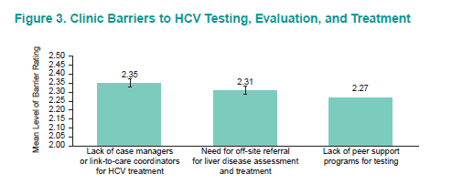
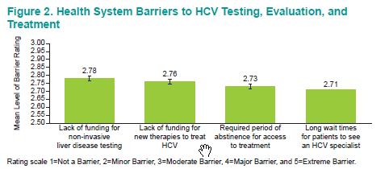
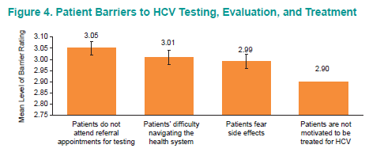
AASLD 2017

Slide 12
4.
Physician Knowledge & Opinions

Slide 13
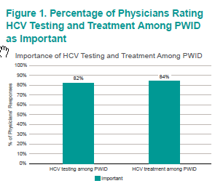
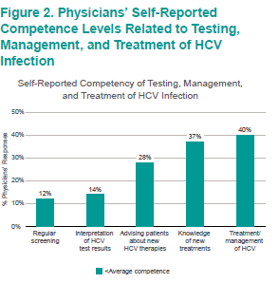
The majority of Physicians considers testing and treatment of PWID as important, but there is a need for education related to HCV Treatment
INHSU 2017

Slide 14
Summary
Addiction specialists manage a high load of patients with competing health priorities (HCV is not the most prevalent co-morbidity)
Physicians are convinced of the need to screen and treat PWID, but the majority of clinics do not have a protocol for testing
There is a lack of support in the clinic to optimize HCV treatment
Major perceived barriers to HCV testing, evaluation and treatment included
Patients not attending referral appointment and lack of awareness of new treatment
Lack of funding for non-invasive liver disease testing
Lack of case managers or link-to-care coordinators (mean 2.35)
Lhe need for off-site referral for liver disease assessment/treatment (mean 2.31)
There is a need to educate physicians on HCV treatment

